Slide 1

Notes:
Source: Oxford International Lower Secondary Computing Student Book 8, 2.1 Using computers for learning, printed pages 34–37. Visuals are generated conceptual illustrations.

Slide 2
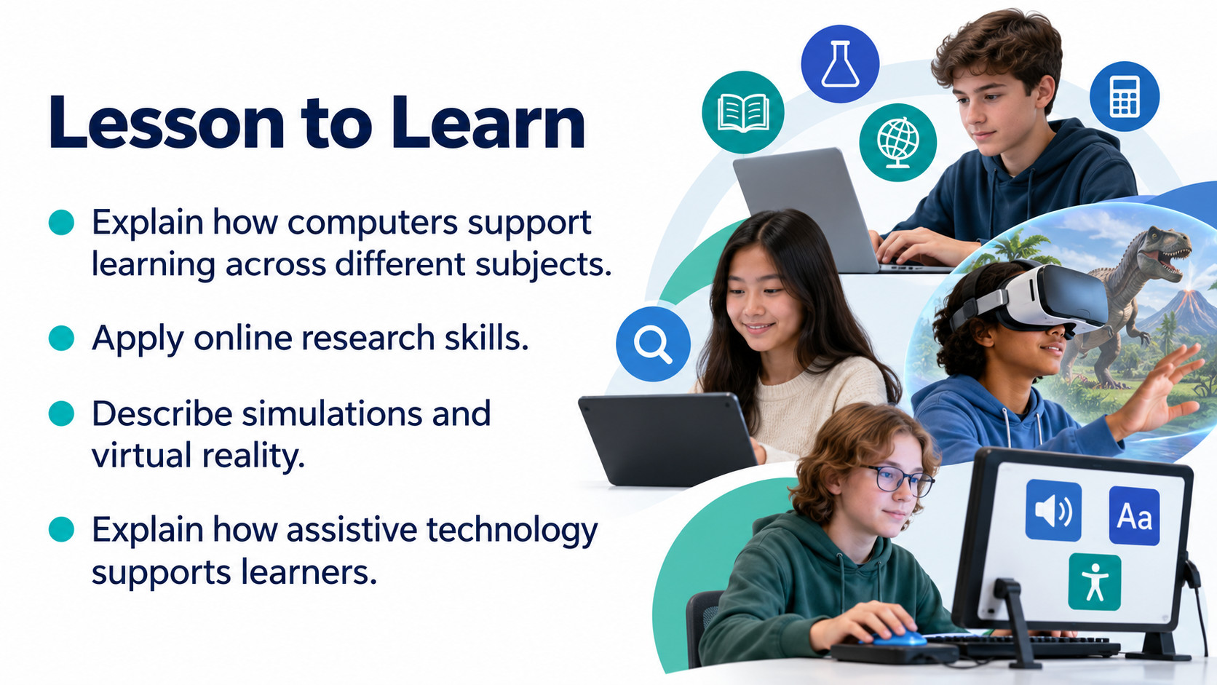
Notes:
Source: Oxford International Lower Secondary Computing Student Book 8, 2.1 Using computers for learning, printed pages 34–37. Visuals are generated conceptual illustrations.

Slide 3

Notes:
Source: Oxford International Lower Secondary Computing Student Book 8, 2.1 Using computers for learning, printed pages 34–37. Visuals are generated conceptual illustrations.

Slide 4

Notes:
Source: Oxford International Lower Secondary Computing Student Book 8, 2.1 Using computers for learning, printed pages 34–37. Visuals are generated conceptual illustrations.

Slide 5

Notes:
Source: Oxford International Lower Secondary Computing Student Book 8, 2.1 Using computers for learning, printed pages 34–37. Visuals are generated conceptual illustrations.

Slide 6

Notes:
Source: Oxford International Lower Secondary Computing Student Book 8, 2.1 Using computers for learning, printed pages 34–37. Visuals are generated conceptual illustrations.

Slide 7

Notes:
Source: Oxford International Lower Secondary Computing Student Book 8, 2.1 Using computers for learning, printed pages 34–37. Visuals are generated conceptual illustrations.

Slide 8

Notes:
Source: Oxford International Lower Secondary Computing Student Book 8, 2.1 Using computers for learning, printed pages 34–37. Visuals are generated conceptual illustrations.

Slide 9

Notes:
Source: Oxford International Lower Secondary Computing Student Book 8, 2.1 Using computers for learning, printed pages 34–37. Visuals are generated conceptual illustrations.

Slide 10

Notes:
Source: Oxford International Lower Secondary Computing Student Book 8, 2.1 Using computers for learning, printed pages 34–37. Visuals are generated conceptual illustrations.

Slide 11
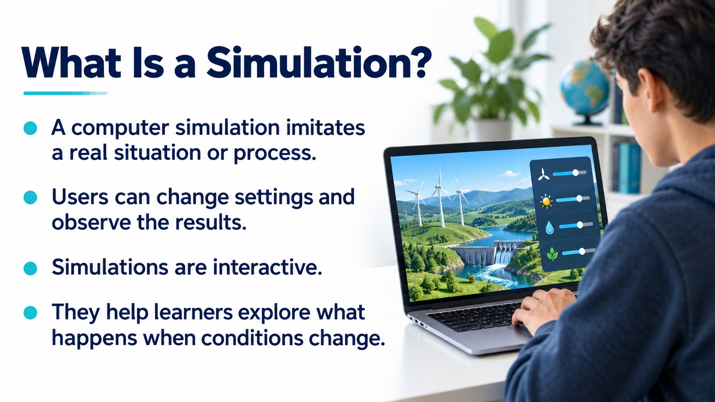
Notes:
Source: Oxford International Lower Secondary Computing Student Book 8, 2.1 Using computers for learning, printed pages 34–37. Visuals are generated conceptual illustrations.

Slide 12
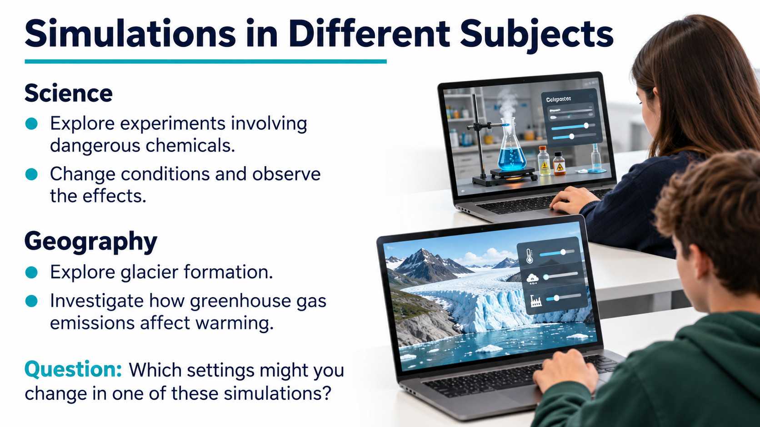
Notes:
Source: Oxford International Lower Secondary Computing Student Book 8, 2.1 Using computers for learning, printed pages 34–37. Visuals are generated conceptual illustrations.

Slide 13
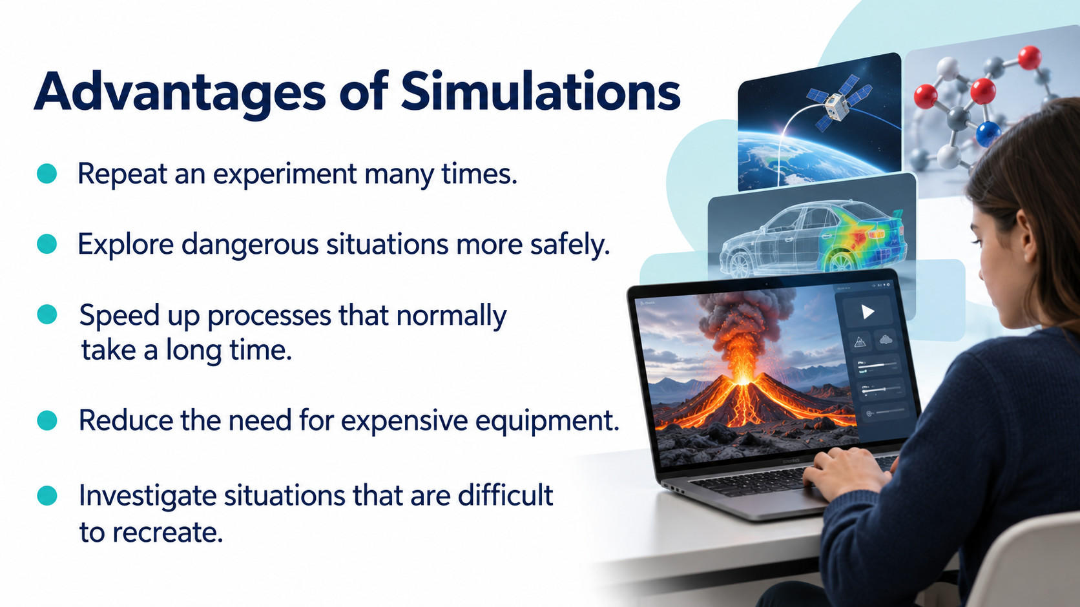
Notes:
Source: Oxford International Lower Secondary Computing Student Book 8, 2.1 Using computers for learning, printed pages 34–37. Visuals are generated conceptual illustrations.

Slide 14
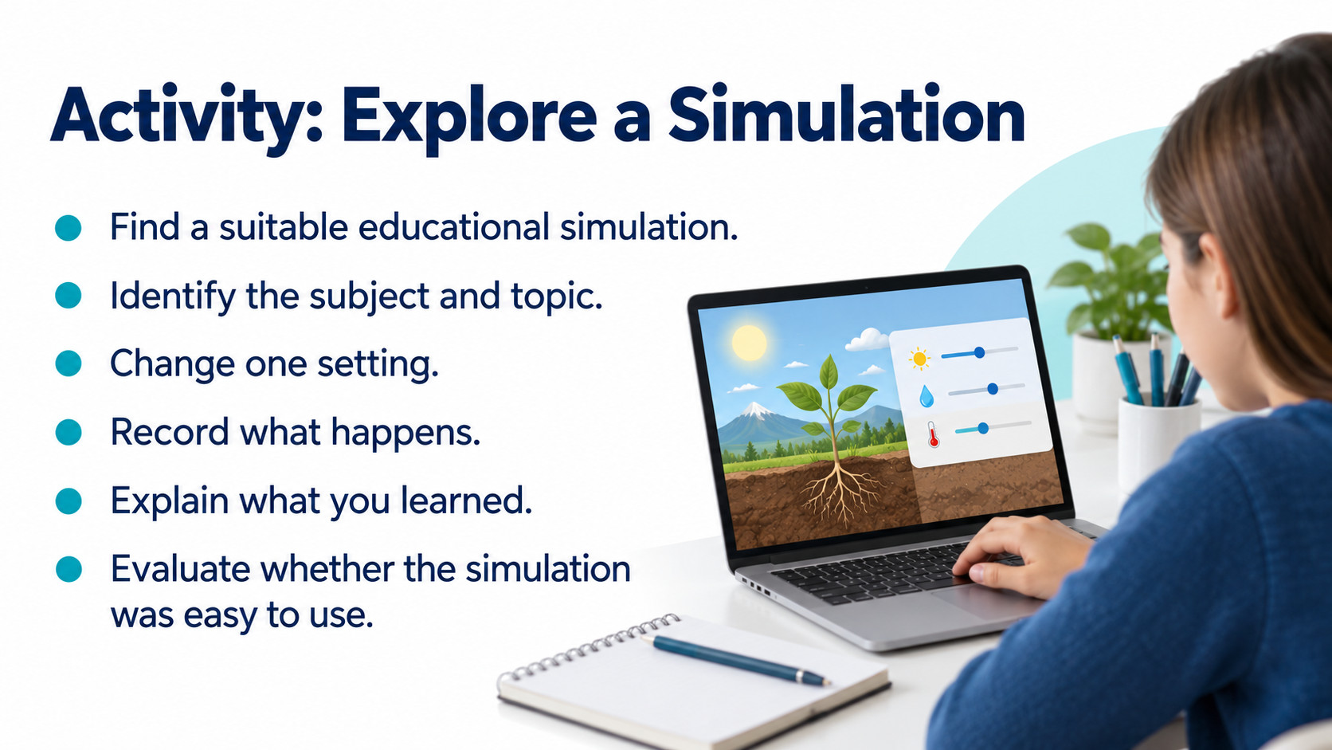
Notes:
Source: Oxford International Lower Secondary Computing Student Book 8, 2.1 Using computers for learning, printed pages 34–37. Visuals are generated conceptual illustrations.

Slide 15
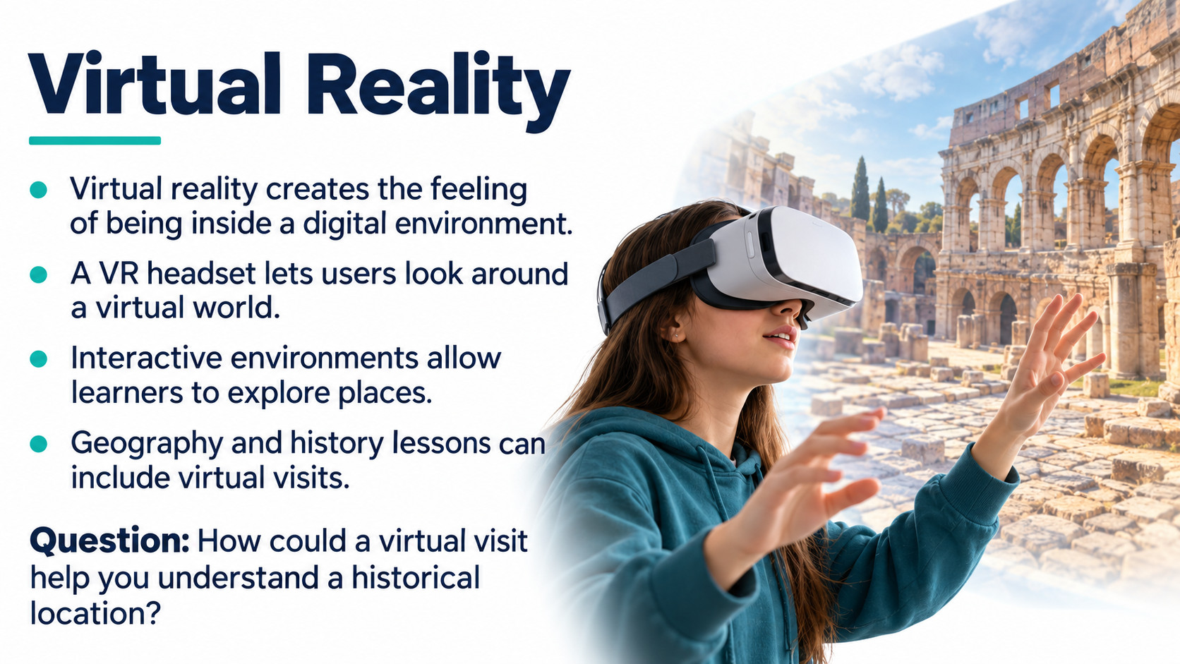
Notes:
Source: Oxford International Lower Secondary Computing Student Book 8, 2.1 Using computers for learning, printed pages 34–37. Visuals are generated conceptual illustrations.

Slide 16
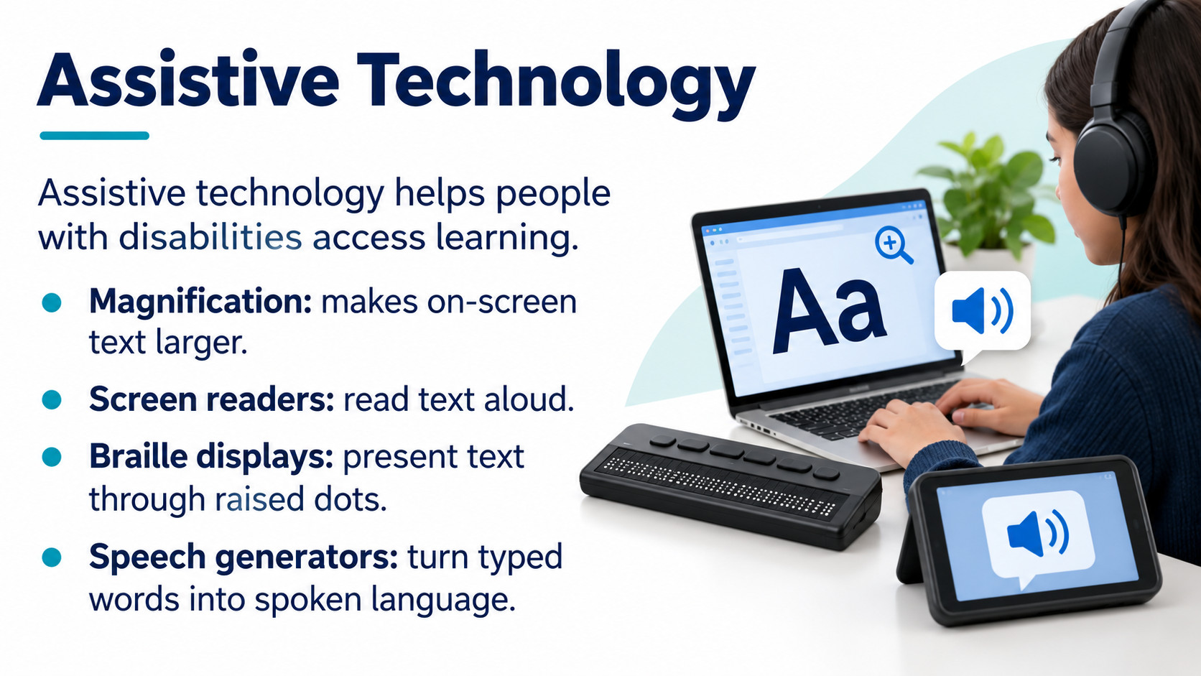
Notes:
Source: Oxford International Lower Secondary Computing Student Book 8, 2.1 Using computers for learning, printed pages 34–37. Visuals are generated conceptual illustrations.

Slide 17
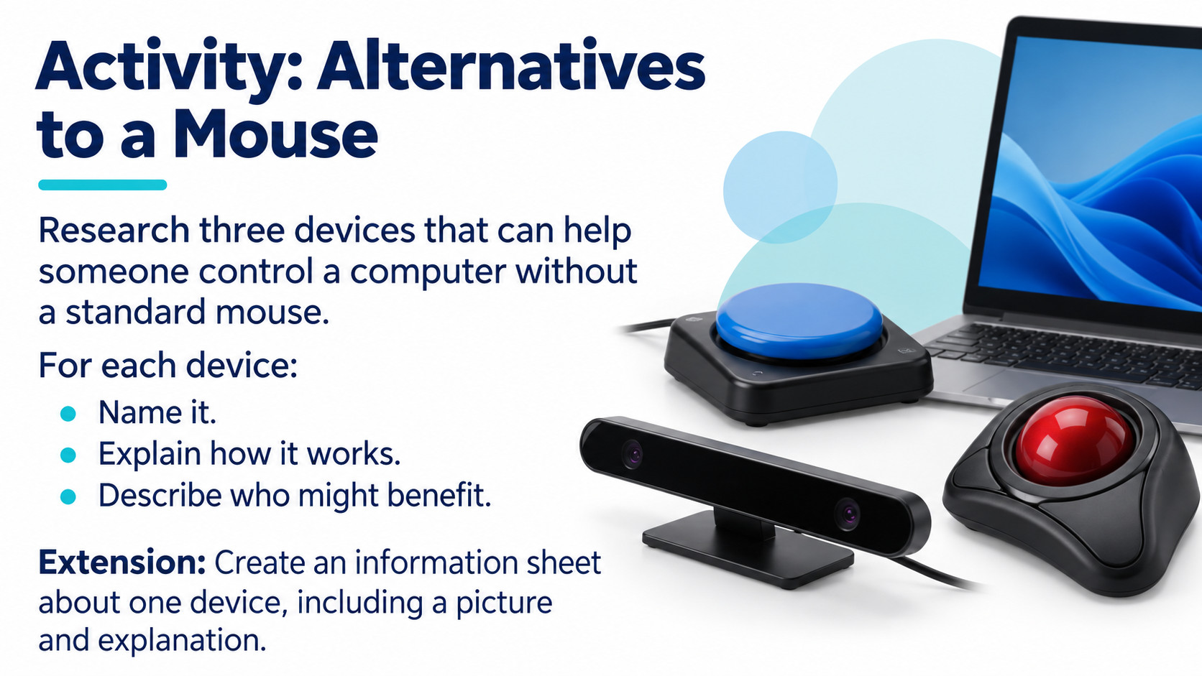
Notes:
Source: Oxford International Lower Secondary Computing Student Book 8, 2.1 Using computers for learning, printed pages 34–37. Visuals are generated conceptual illustrations.

Slide 18

Notes:
Source: Oxford International Lower Secondary Computing Student Book 8, 2.1 Using computers for learning, printed pages 34–37. Visuals are generated conceptual illustrations.

